Slide 1
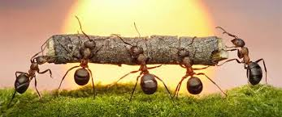
BUKANINDALO NPC PRESENTATION
Presented By Pearl Jonas
Notes:
To give a bit of background, this year WESSA is 90 years young. Almost a century of people caring for the earth.
We recognized a long time ago that in order to take care of the earth, we have to take care of people and in 2003 we joined hands with the Foundation for Environmental Education based in Denmark.
We are 1 of 64 countries in the world operating the FEE Eco-Schools programme and globally 49 000 schools are involved.

Slide 2

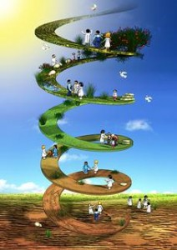
WHY DO WE EXIST
A VEHICLE FOR TRANSFORMATION
TO PROMOTE SOCIO-ECONOMIC DEVELOPMENT THROUGH WELL DESIGNED PROGRAMS, ie. ARTS & CULTURE, SPORTS TOURISM AND HERITAGE
TO CONTRIBUTE TOWARDS JOB CREATION, YUTH PARTICIPATION, ERADICATION OF POVERTY & EQUALITY BY CREATING PACKAGES THAT BENEFITS PREVIOUSLY DISADVANTAGED GROUPS

Slide 3
BUKANINDALO SECTORS
ENVIRONMENT
EDUCATION & EMPOWERMENT
POVERTY ALLEVIATION
ARTS & CULTURE
SPORT & TOURISM
TOUR OPERATIONS

Slide 4


Slide 5
ENVIRONMENT
Everything that is around us-
Living or Non-Living
Fosters a sense of connection to the natural world
Encourages Conservation of irreplaceable Natural Resources and vulnerable plant and animal species
Water
Air
Promotes Sustainable Development
A tool to help people to understand the importance of preserving resources
Soil

Slide 6

ENVIRONMENT
AIM
TO STIMULATE LOVE AND RESPECT FOR NATURE WHILE WE EQUIP AND MOTIVATE INDIVIDUALS AND COMMUNITIES TOWARDS ATTITUDINAL CHANGE AND LIFESTYLES THAT PROMOTE ENVIRONMENTAL SUSTAINABILITY

Slide 7
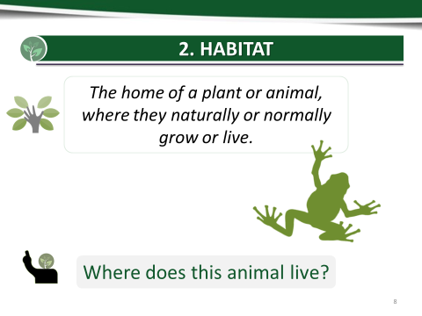
HABITAT

Slide 8
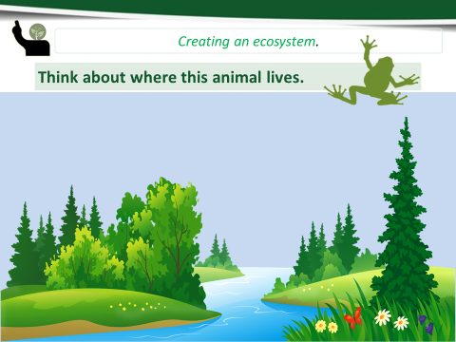
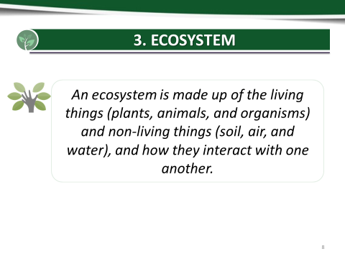
ECOSYSTEM

Slide 9
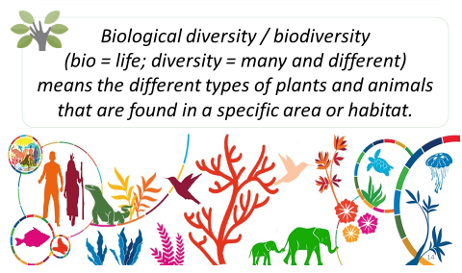
BIODIVERSITY

Slide 10
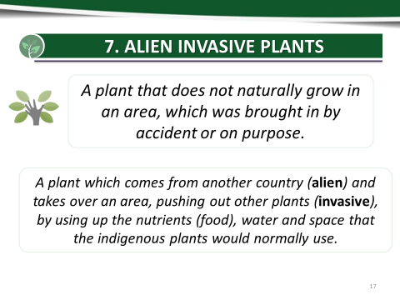
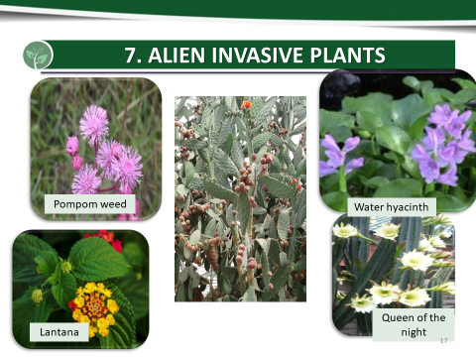
ALIEN INVASIVE PLANTS

Slide 11

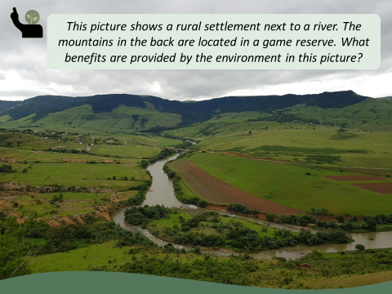
WHAT BENEFITS ARE PROVIDED BY THE ENVIRONMENT HERE?

Slide 12
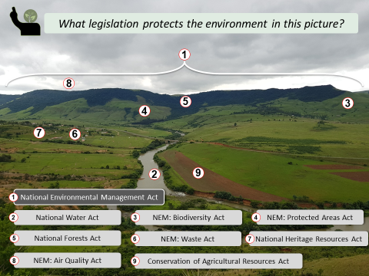

Slide 13
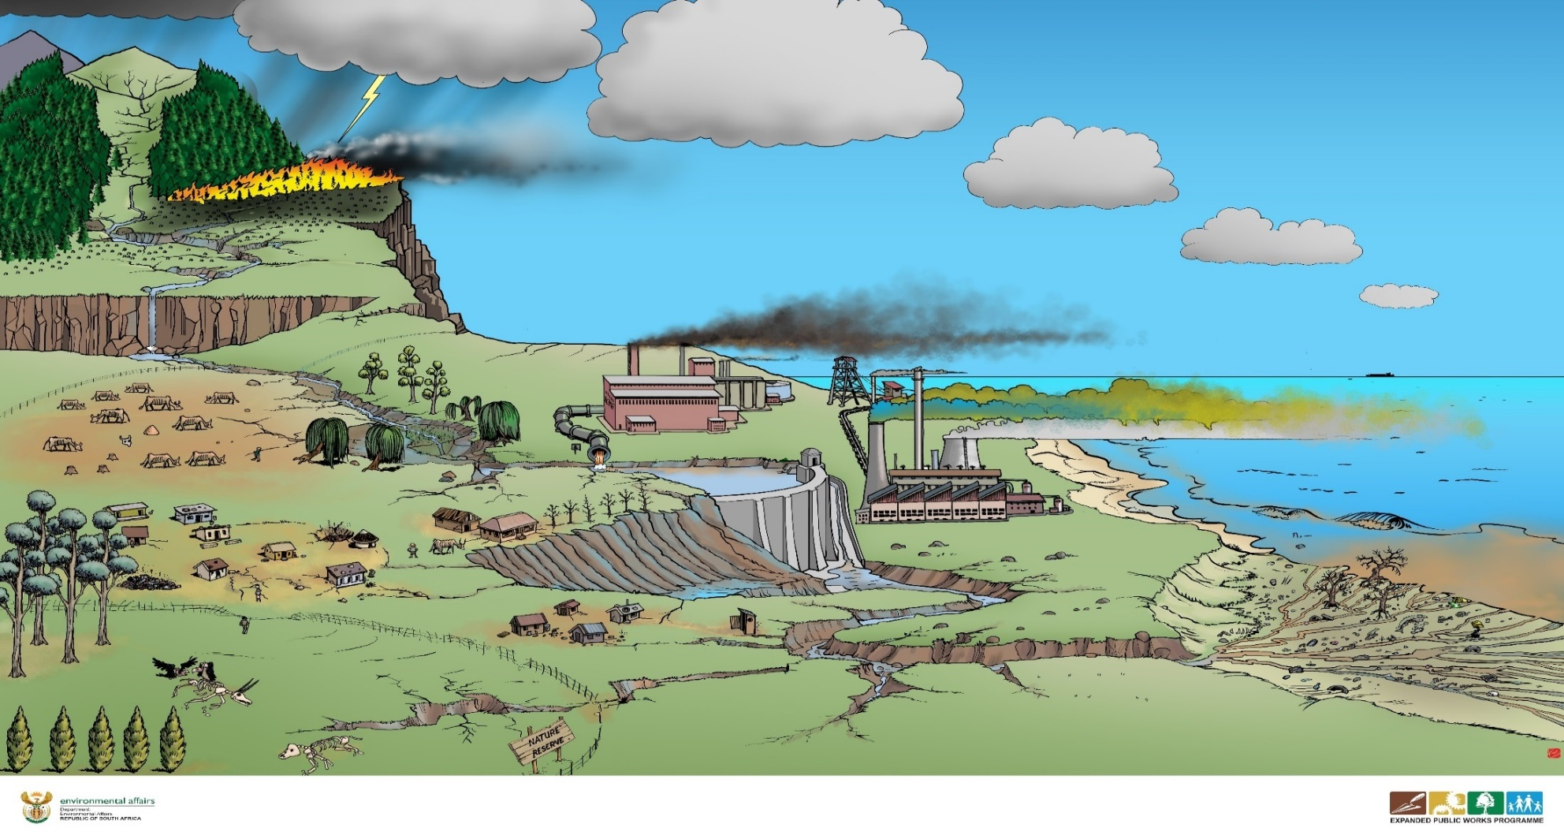
BUT WHO DESTROYS ALL OF THESE?
HUMANS
CLIMATE CHANGE

